Slide 1
International Monetary System

Slide 2
Definition of International Monetary System
The international monetary system (IMS) is the institutional framework within which
International payment are made.
Movements of capital are accommodated.
Exchange rate among currencies are determined.

Slide 3
Why do we need to study international monetary system?
International monetary system defines the overall financial environment in which multinational corporations and international investors operate.
It is essential for managers to understand the arrangements, workings and the dynamic nature of international monetary system.

Slide 4
Learning Objectives
Explore how the international monetary system has evolved.
Examine how the choice of fixed versus floating exchange rate regimes is made by a country.
Notes:
The IMS has evolved over time and will continue to do so as the fundamental business and political conditions underlying the world economy continue to shift.

Slide 5
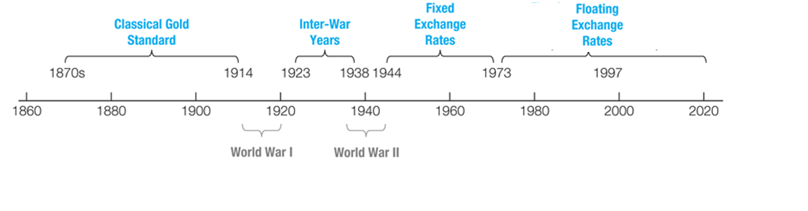
Evolution of the International Monetary System

Slide 6
The Gold Standard (1876-1913)
“Rules of the game”: each country set the rate at which its currency unit could be converted to a weight of gold.
Exchange rates among currencies is determined by their gold contents.
Example: if the France franc is pegged to gold at Fr 12 = 1 ounce of gold, and the British pound is pegged to gold at £6 = 1 ounce of gold. What is the exchange rate?
Pros: (1)autocorrection of misalignment of exchange rate; (2) control inflation as expansionary monetary policy was limited to a government’s supply of gold.
Cons: (1) deflationary pressure on world economy; (2) depends on each country’s willingness to abide the rules.
Was in effect until the outbreak of WW I interrupted trade flows and free movement of gold.

Slide 7
The Inter-War Years & WWII (1914-1944)
During this period, currencies were allowed to fluctuate over a fairly wide range in terms of gold and each other.
This flexible exchange rates didn’t work in an equilibrating manner as predicted by the theory of supply and demand for a country’s export and import.
Lack of the political will to “follow the rules” .
Illiquid forward exchange market.
It is detrimental to international trade and investment.
The volume of international trade didn’t grow in proportion to world GDP, it even declined to a very low level with the Great Depression.

Slide 8
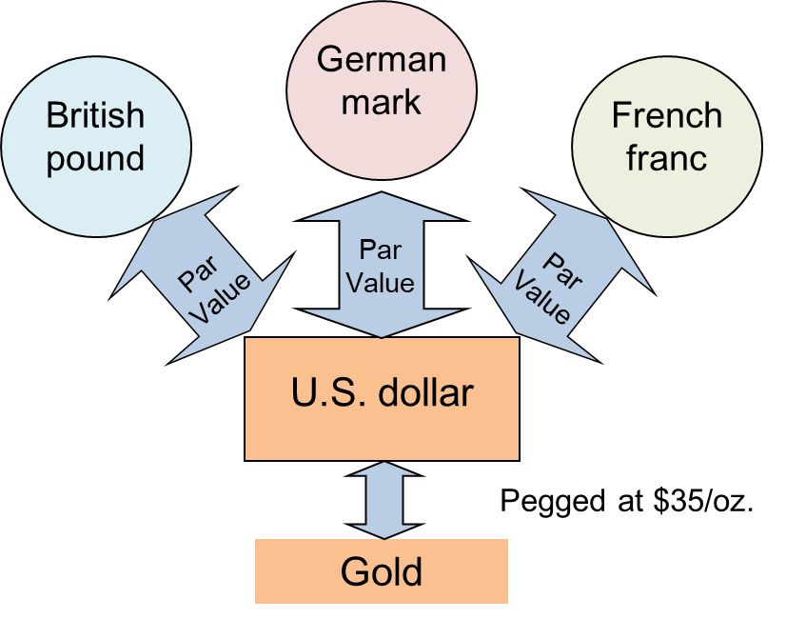
Fixed Exchange Rates (1945-1973)
In 1944, a meeting of 44 nations at Bretton Woods, NH established a U.S. dollar-based international monetary system.
Each country established a par value relative to the U.S. dollar.
Only dollar remained convertible into gold at $35 per ounce.
Each country maintains the exchange rate within 1% of the par by buying or selling FX or gold.
Gold and U.S. dollars were used as an international means of payment.
The International Monetary Fund (IMF) was created to monitor and enforce this set of rules.

Slide 9
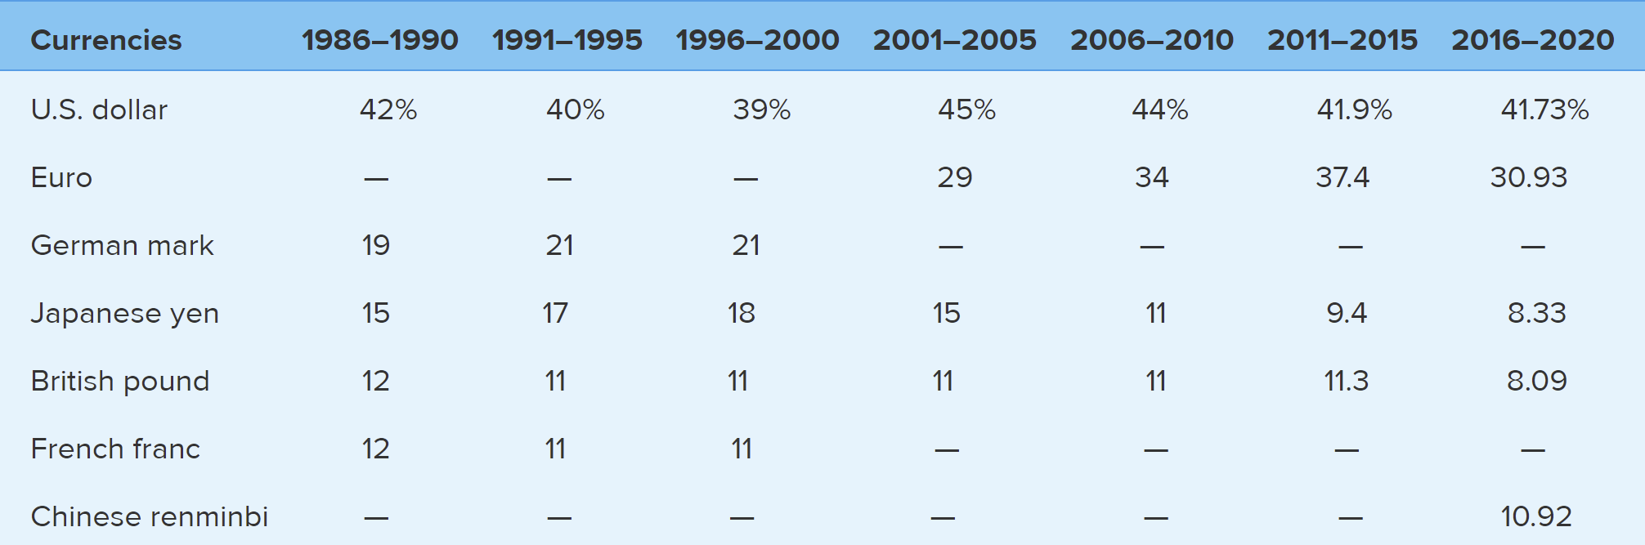
Fixed Exchange Rates (1945-1973) (Cont.)
Advantages:
Exchange rates were stable.
Offset the deflationary effect of limited addition to the world’s monetary gold stock.
Disadvantage:
Triffin paradox: U.S. had to run balance-of-payments deficits continuously to satisfy the growing need for reserves, however, large and persistent deficit will also lead to a crisis of confidence in US dollar.
Remedy to the problem: the creation of a new reserve asset, special drawing rights (SDRs), which is a basket currency comprising major currencies.
Countries could use SDR for international payment. The value is more stable due to the portfolio nature of SDR.
The composition is updated periodically, and the weight reflect the importance of each country in the world trade.
Source: IMF
Notes:
The effort tot support the dollar based exchange rat system is not sufficient. Devaluation of dollar. US inflation and expansionary monetary policy, and inflation. 1971 President Nixon suspend the conversion between $ and gold.Mark pound yen were allow to float in 1971.

Slide 10
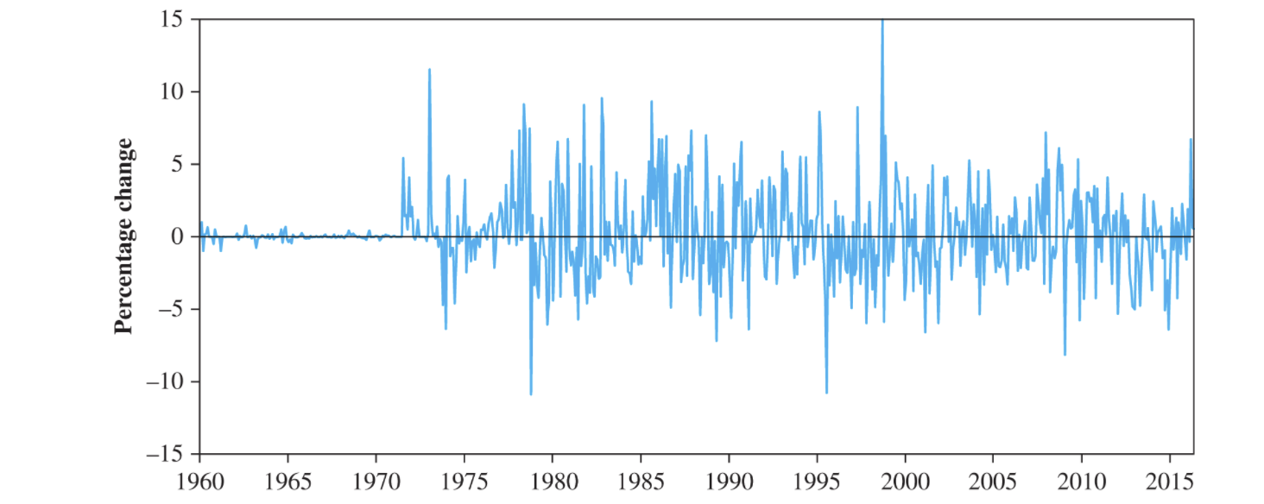
The Floating Exchange Rates (1973-present)
Flexible exchange rates were declared acceptable to the IMF members.
There is no single governing body for the exchange of currencies.
The international monetary system is an eclectic combination of exchange rate regimes.
Exchange rates have become much more volatile and less predictable than they were during the “fixed” period.
Monthly percentage change of the exchange rate between ¥ and $
Copyright © 2019by the McGraw-Hill Companies

Slide 11
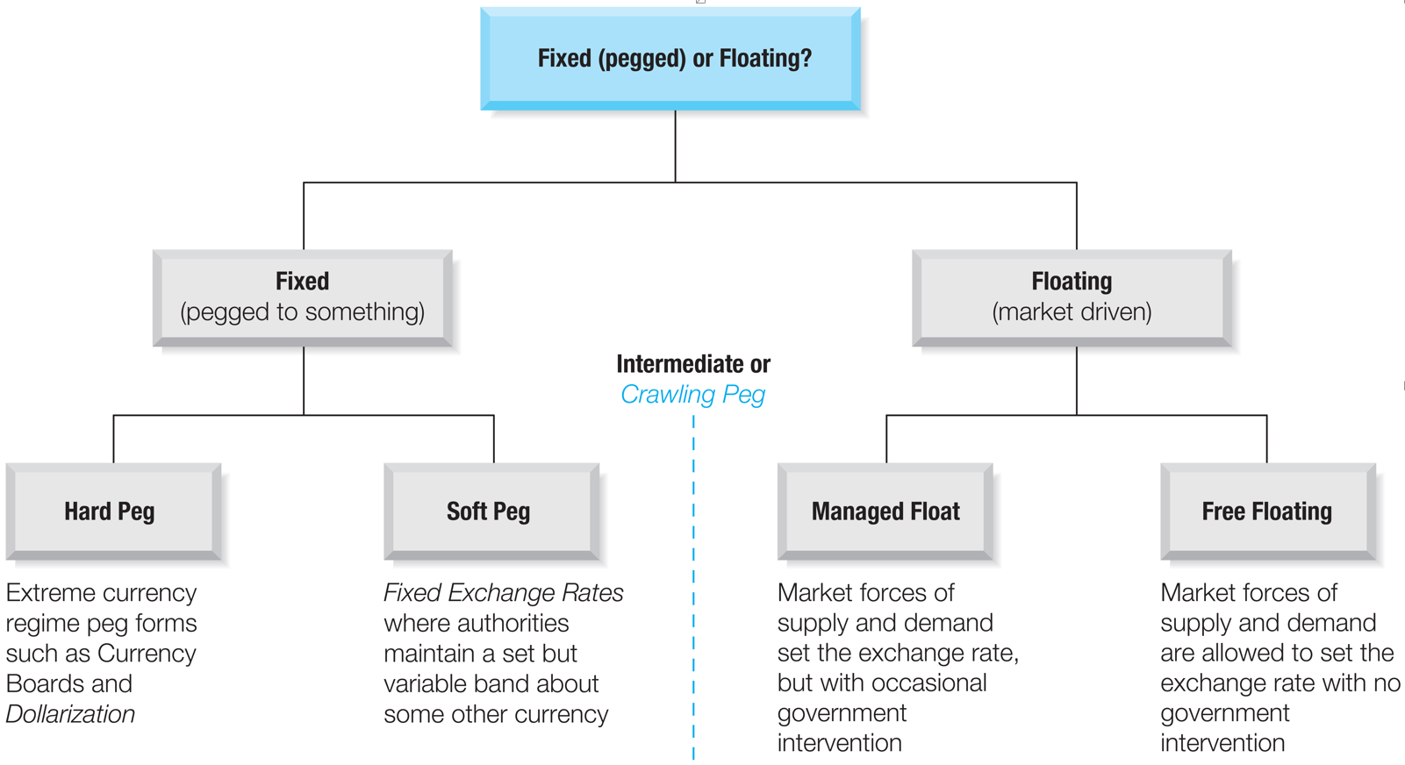
Current Exchange Rate Regimes

Slide 12
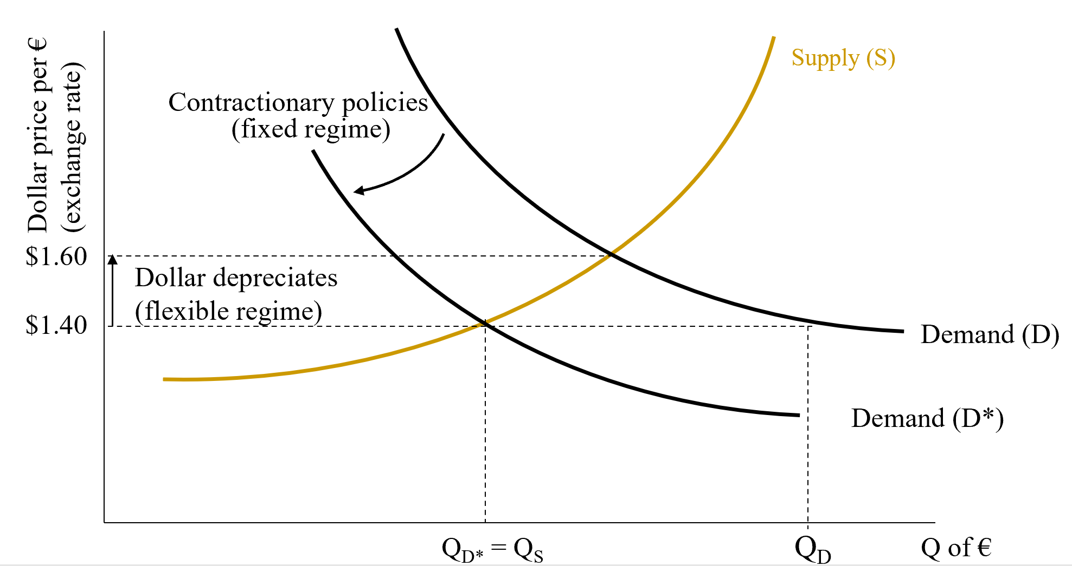
Fixed vs. Floating Exchange Rate Regimes
Arguments in favor of flexible exchange rates:
Easier external adjustments.
National policy autonomy.
Government can use its monetary and fiscal policies to pursue economic goals.
Arguments against flexible exchange rates:
Exchange rate uncertainty may hamper international trade.

Slide 13
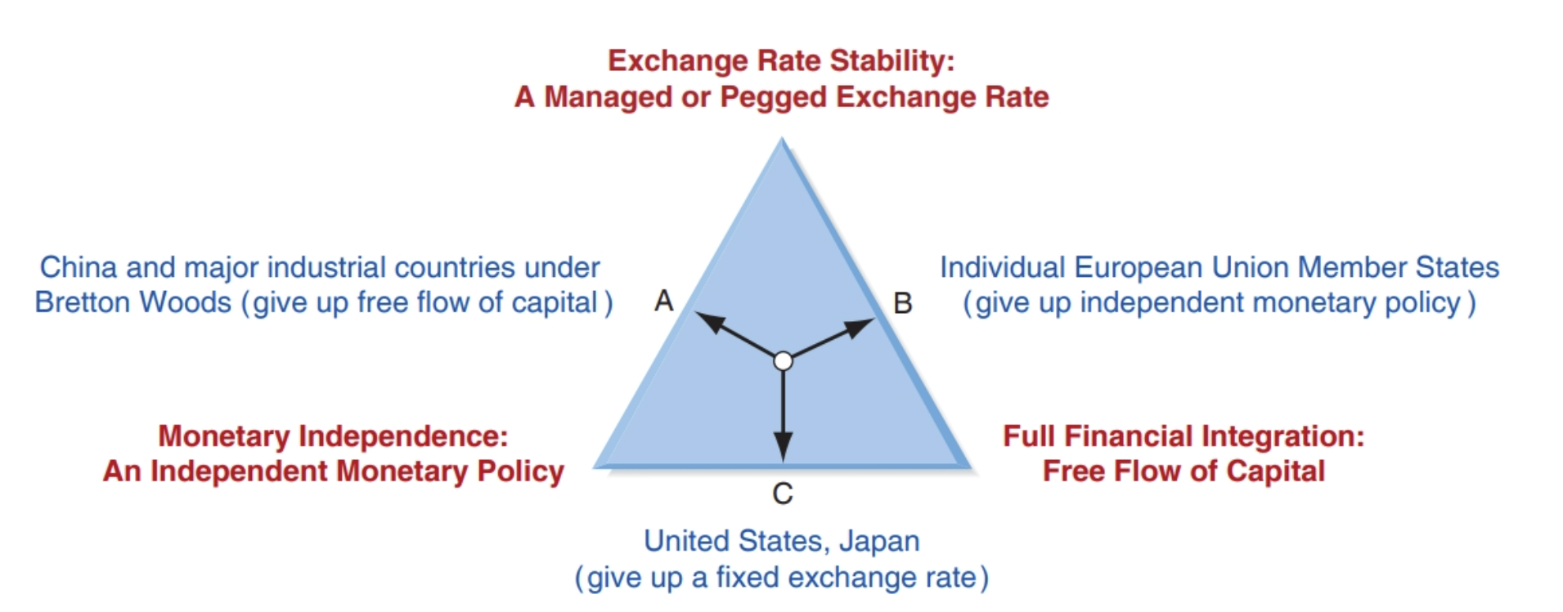
Fixed vs Floating Exchange Rate (Cont.)
A nation’s choice of currency regime involves a trade-off between:
Exchange rate stability
Full financial integration
Monetary independence
Impossible Trinity: the forces of economics do not allow the simultaneous achievement of all three.

Slide 14
An Ideal International Monetary System
Liquidity: provide sufficient monetary reserves to support the growth of international trade and investment.
Adjustment: provide an effective mechanism that restore the balance-of-payment equilibrium when it is disturbed.
Confidence: prevent crises of confidence in the system.

Slide 15
Summary (Learning Objectives Revisit)
Explore how the international monetary system has evolved.
Examine how the choice of fixed versus floating exchange rate regimes is made by a country.

